Slide 1
Kafka Streams and KSQL DB
Subtitle

Slide 2
Title and Content Layout with List
Add your first bullet point here
Add your second bullet point here
Add your third bullet point here

Slide 3
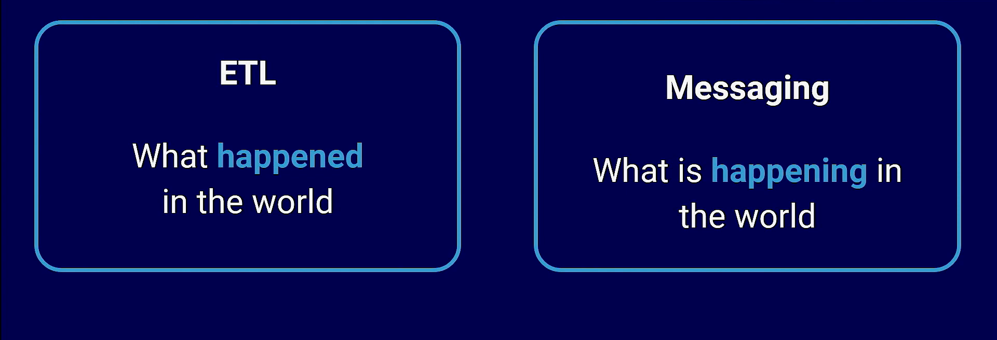
Connecting Applications with Data

Slide 4
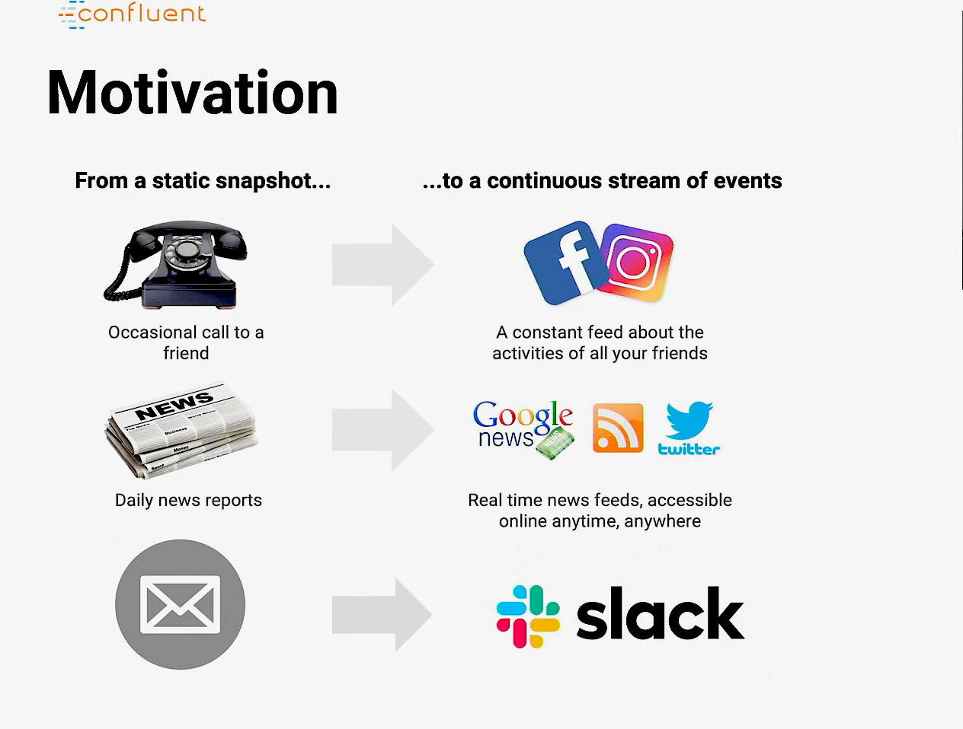

Slide 5
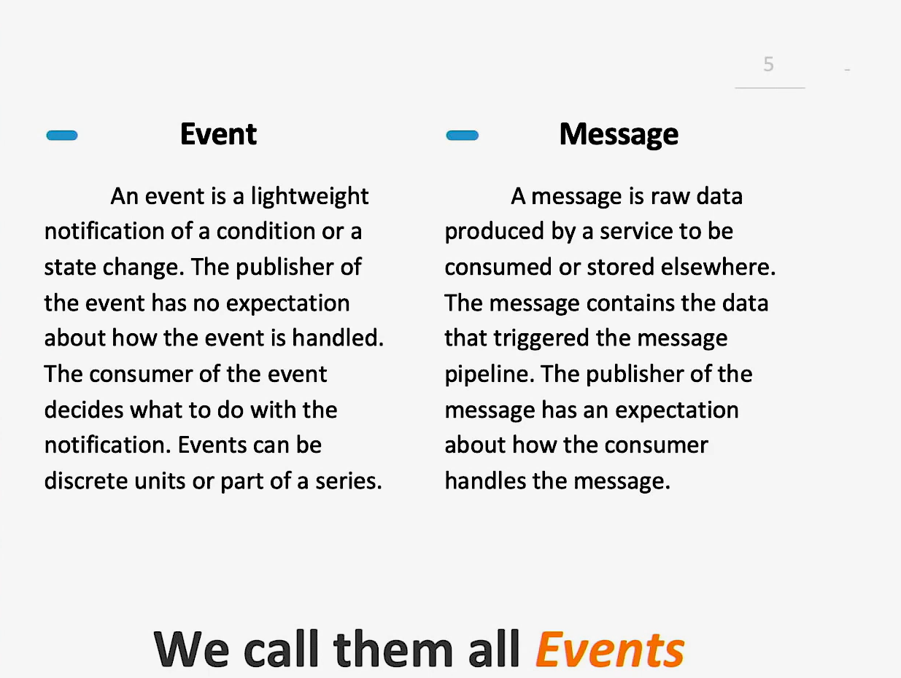

Slide 6
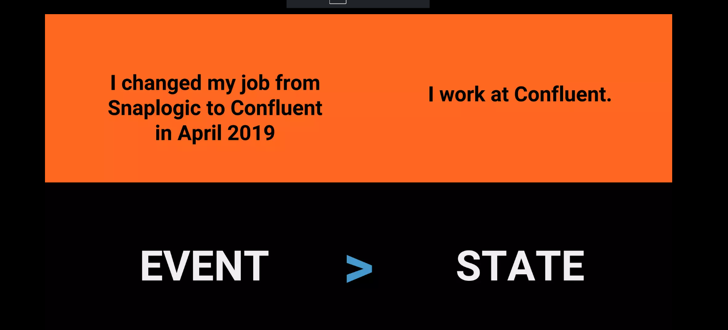

Slide 7
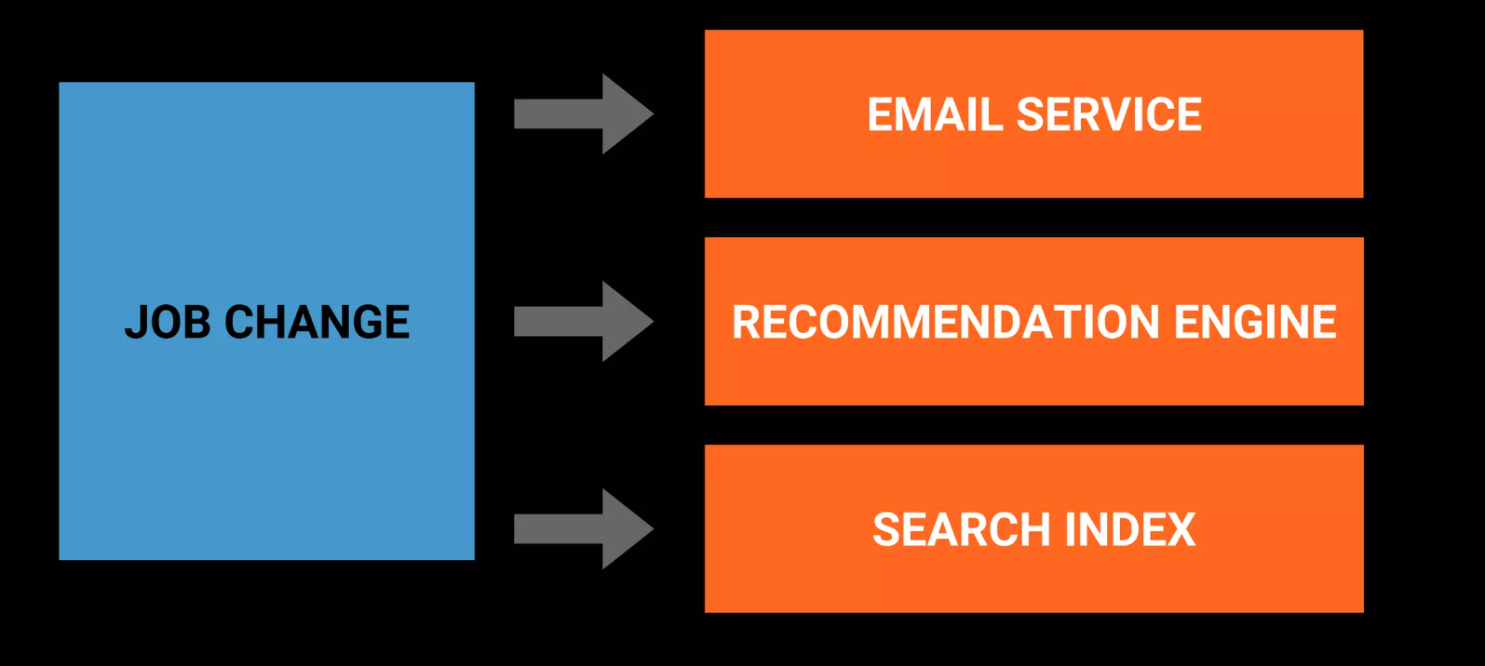

Slide 8
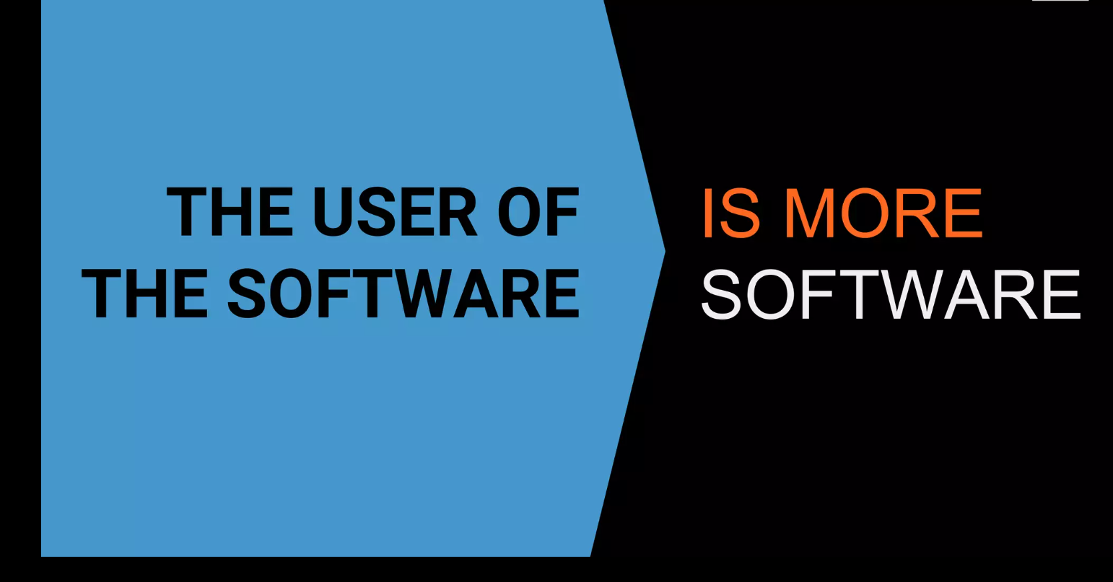

Slide 9
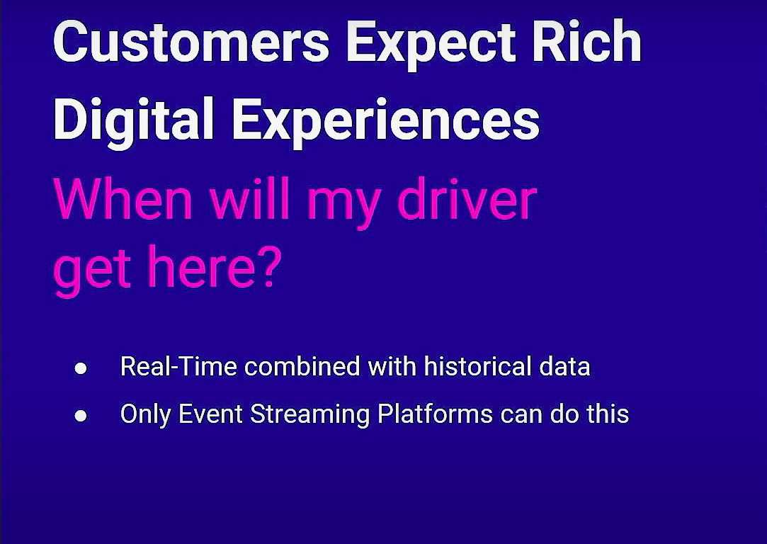

Slide 10
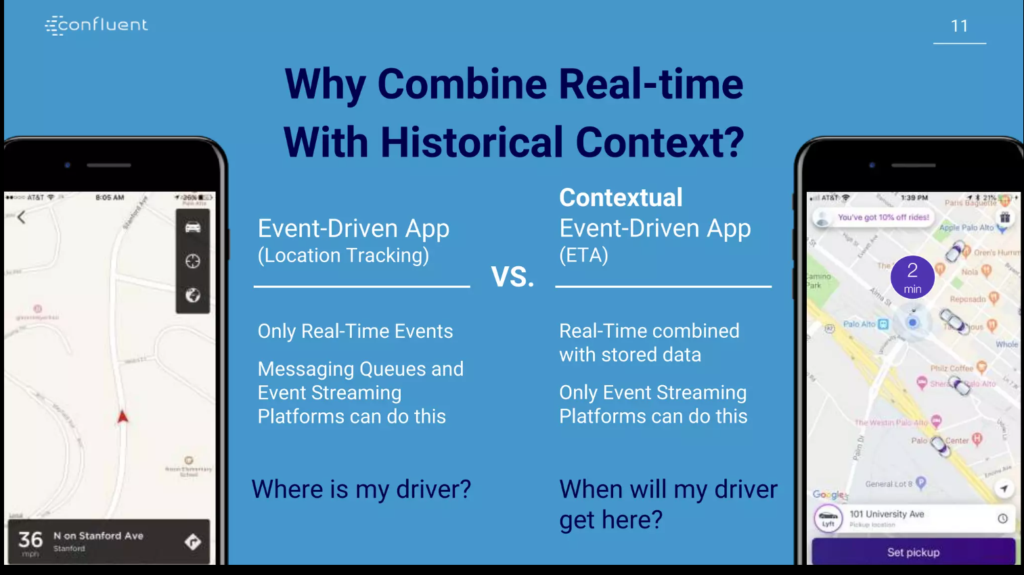

Slide 11
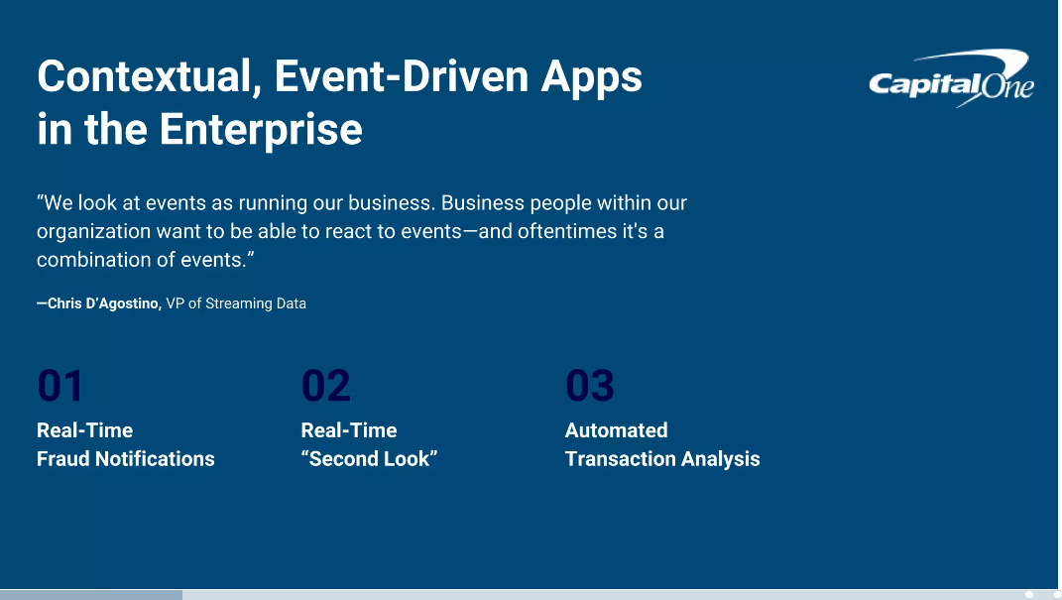

Slide 12
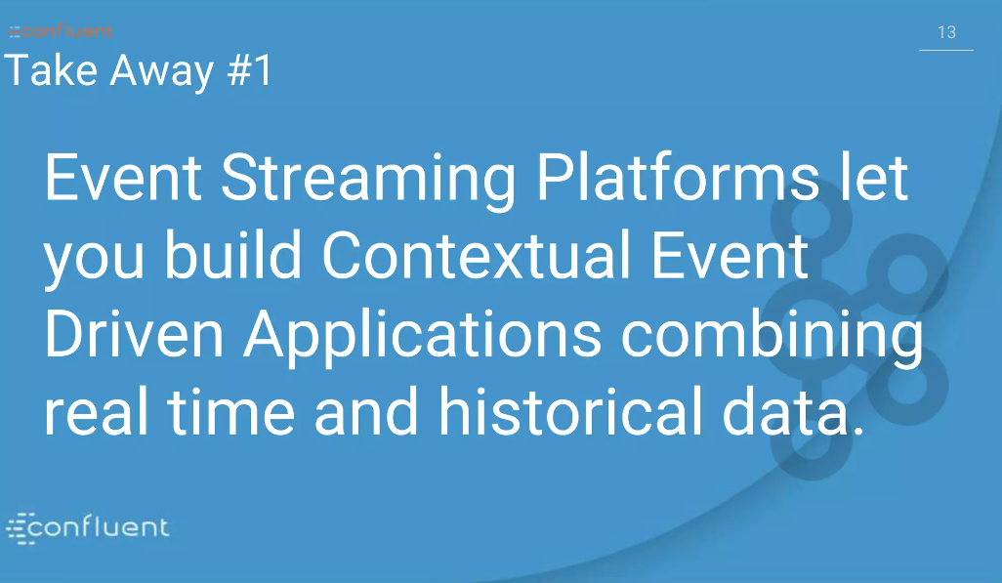

Slide 13
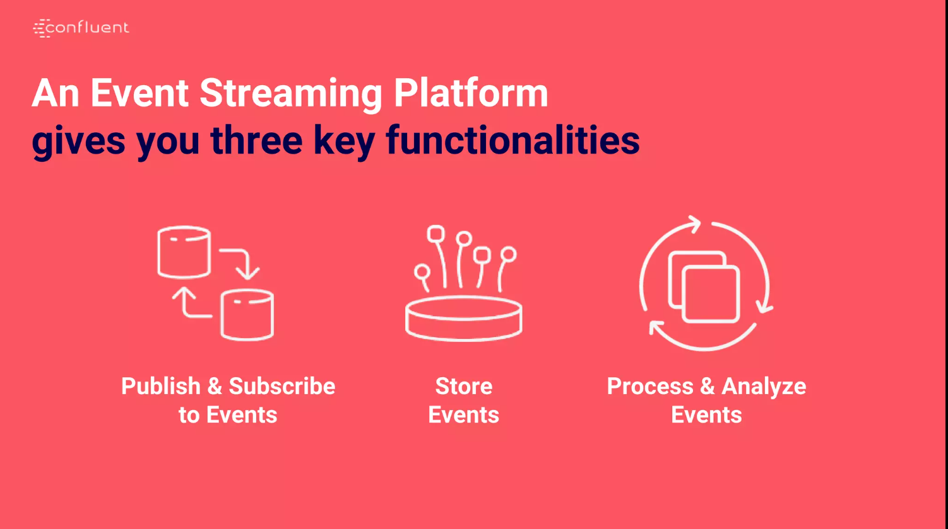

Slide 14
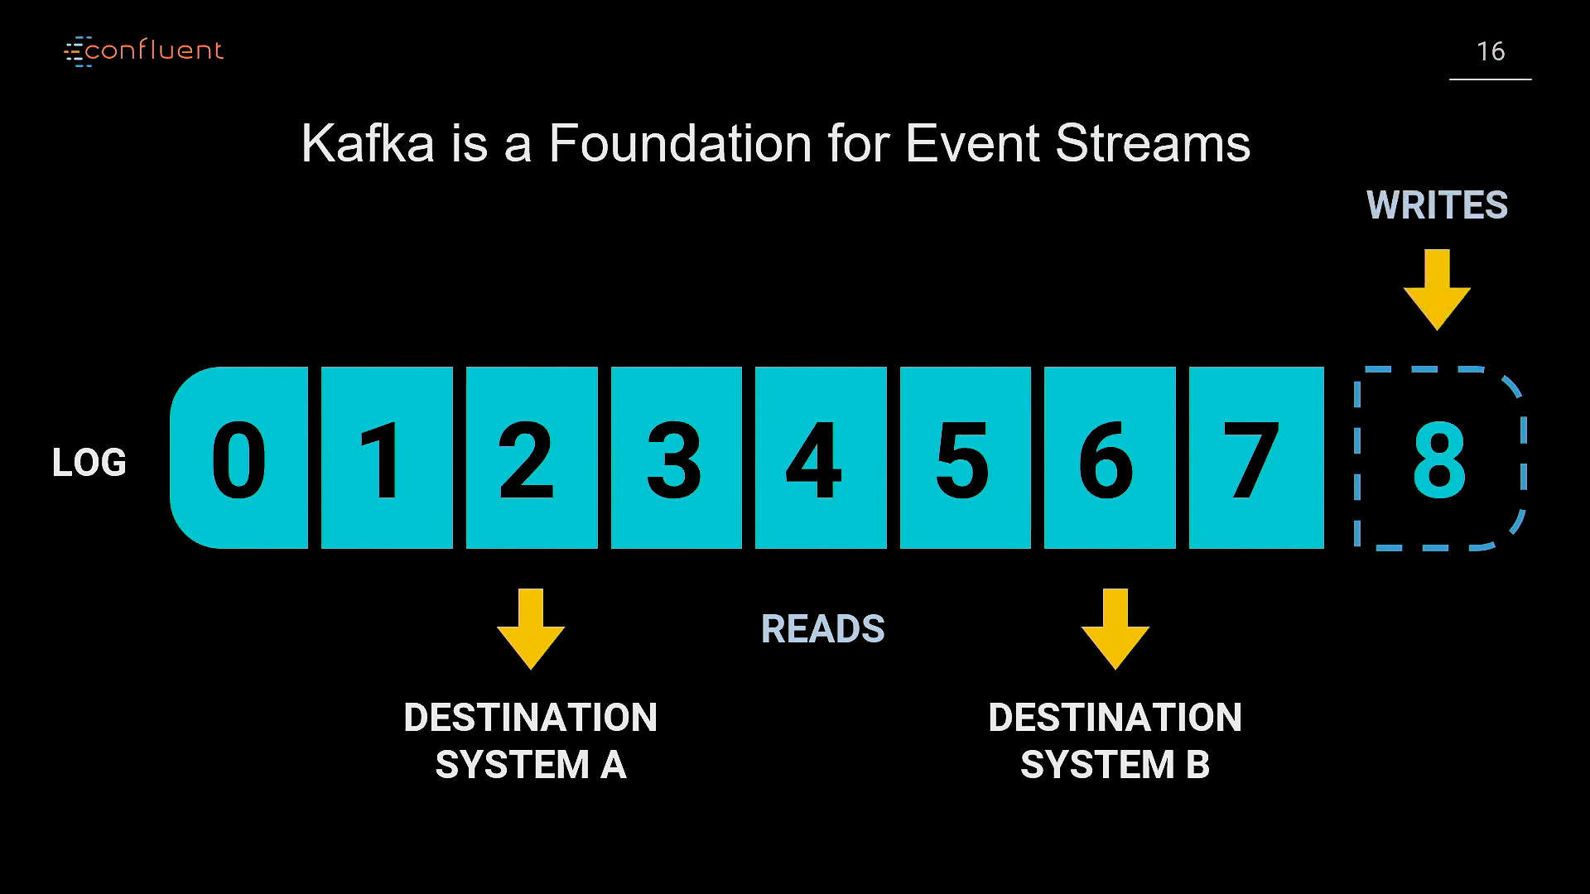

Slide 15
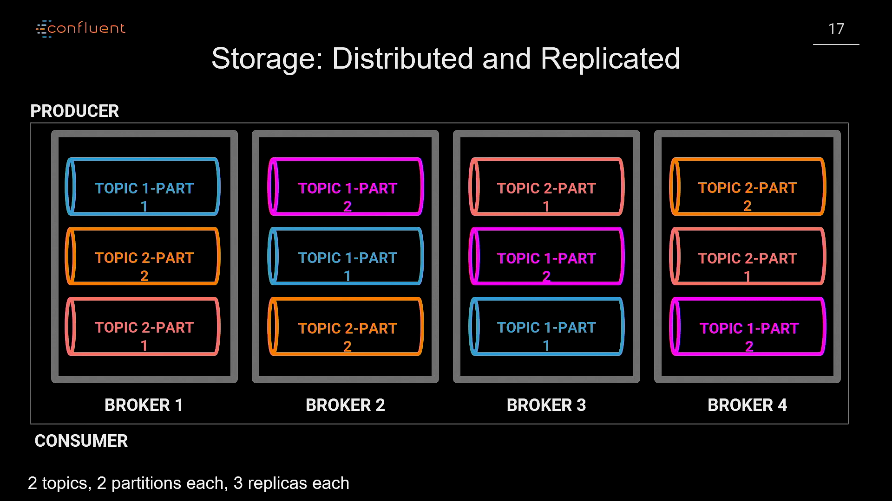

Slide 16
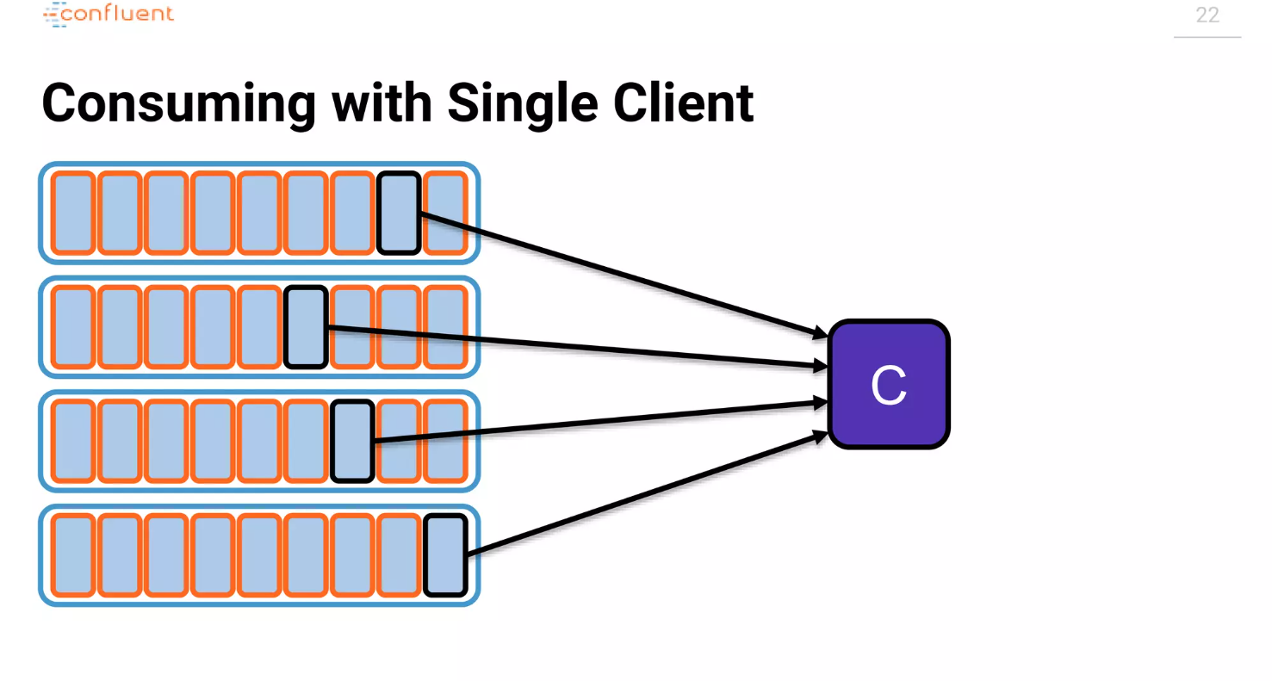

Slide 17
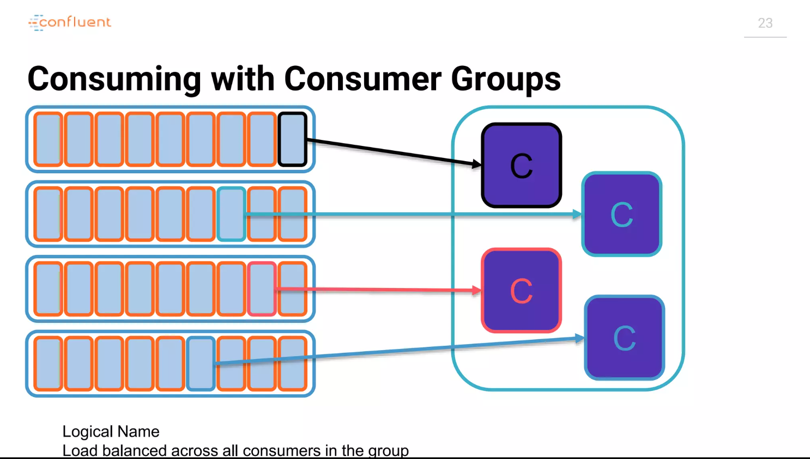

Slide 18
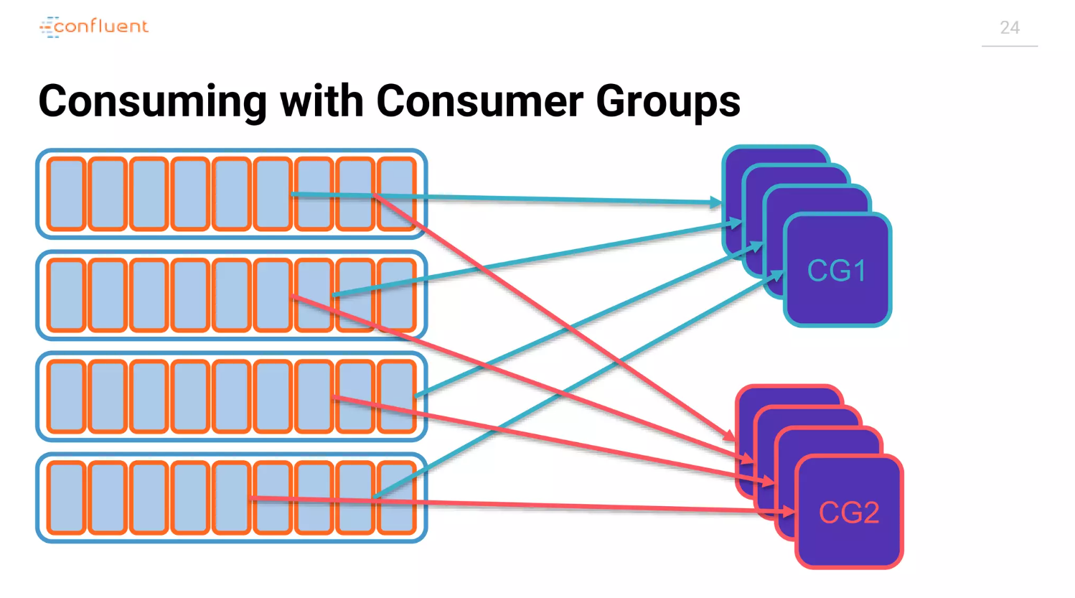

Slide 19
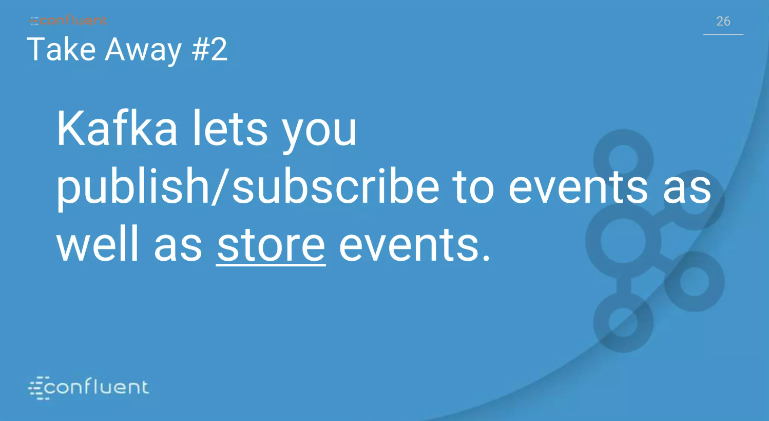

Slide 20
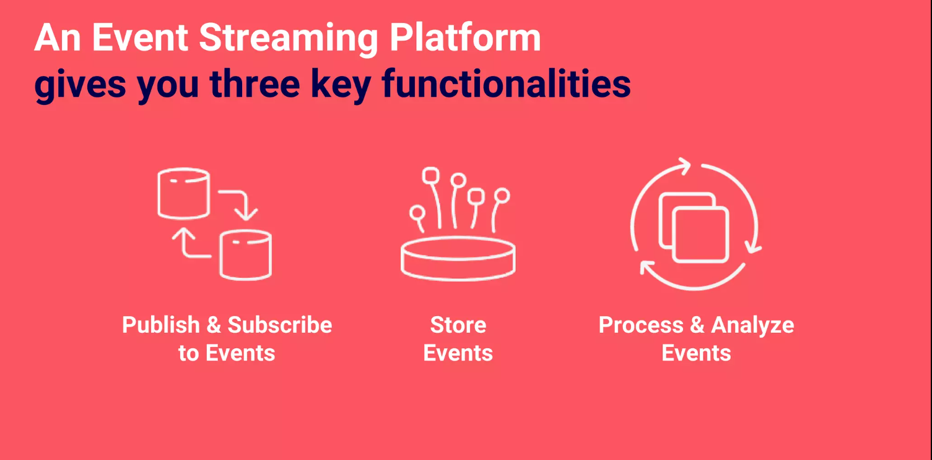

Slide 21
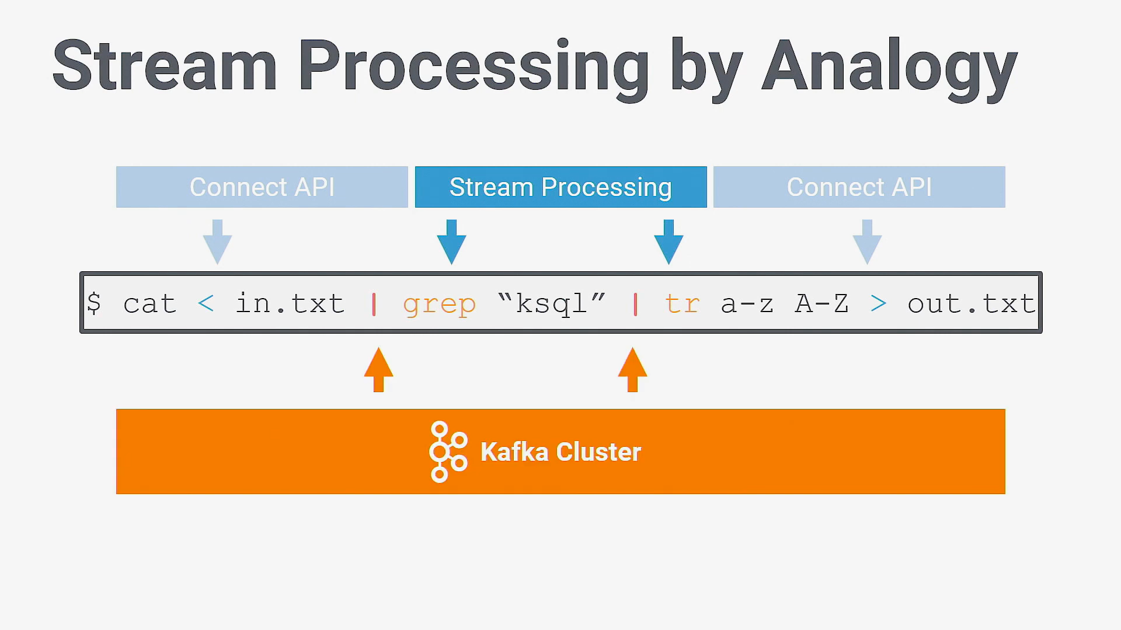

Slide 22
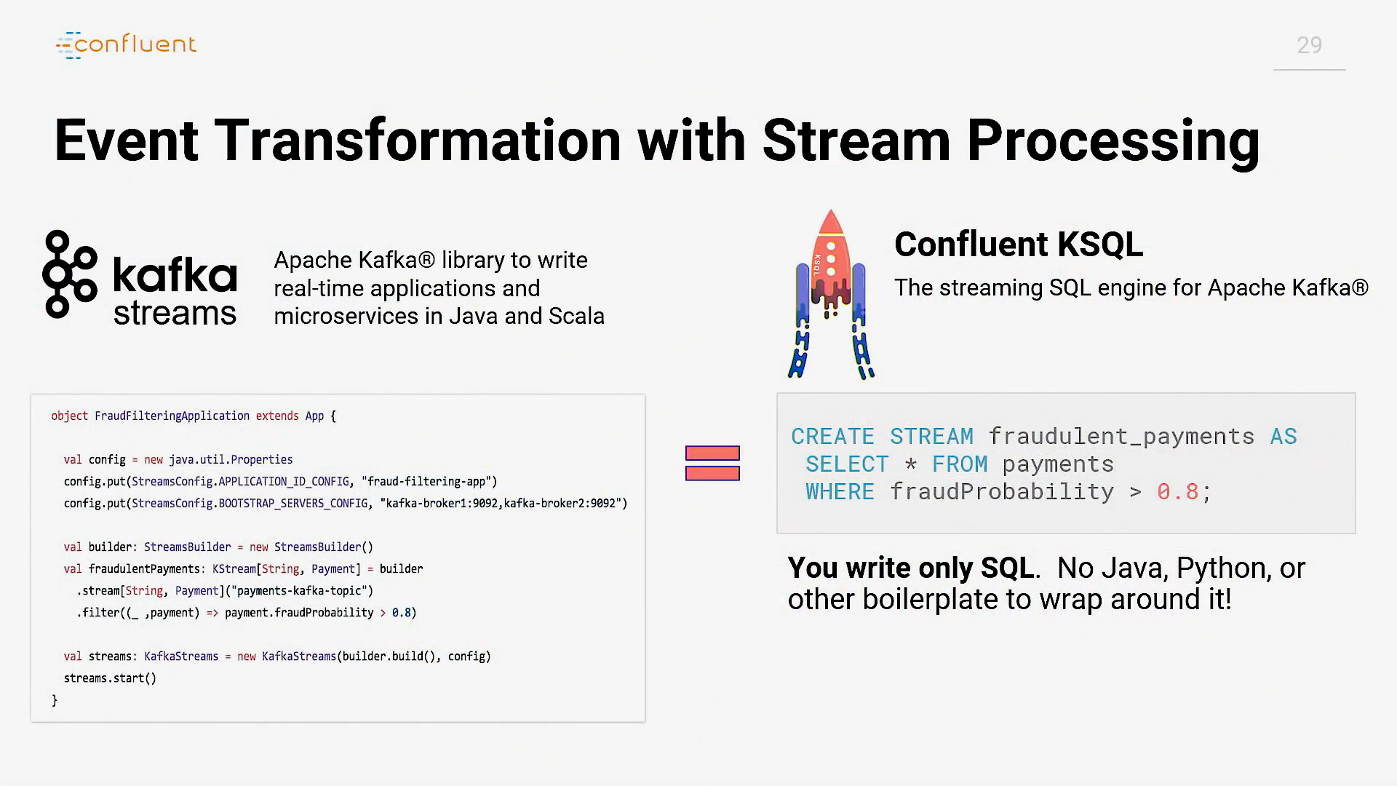

Slide 23
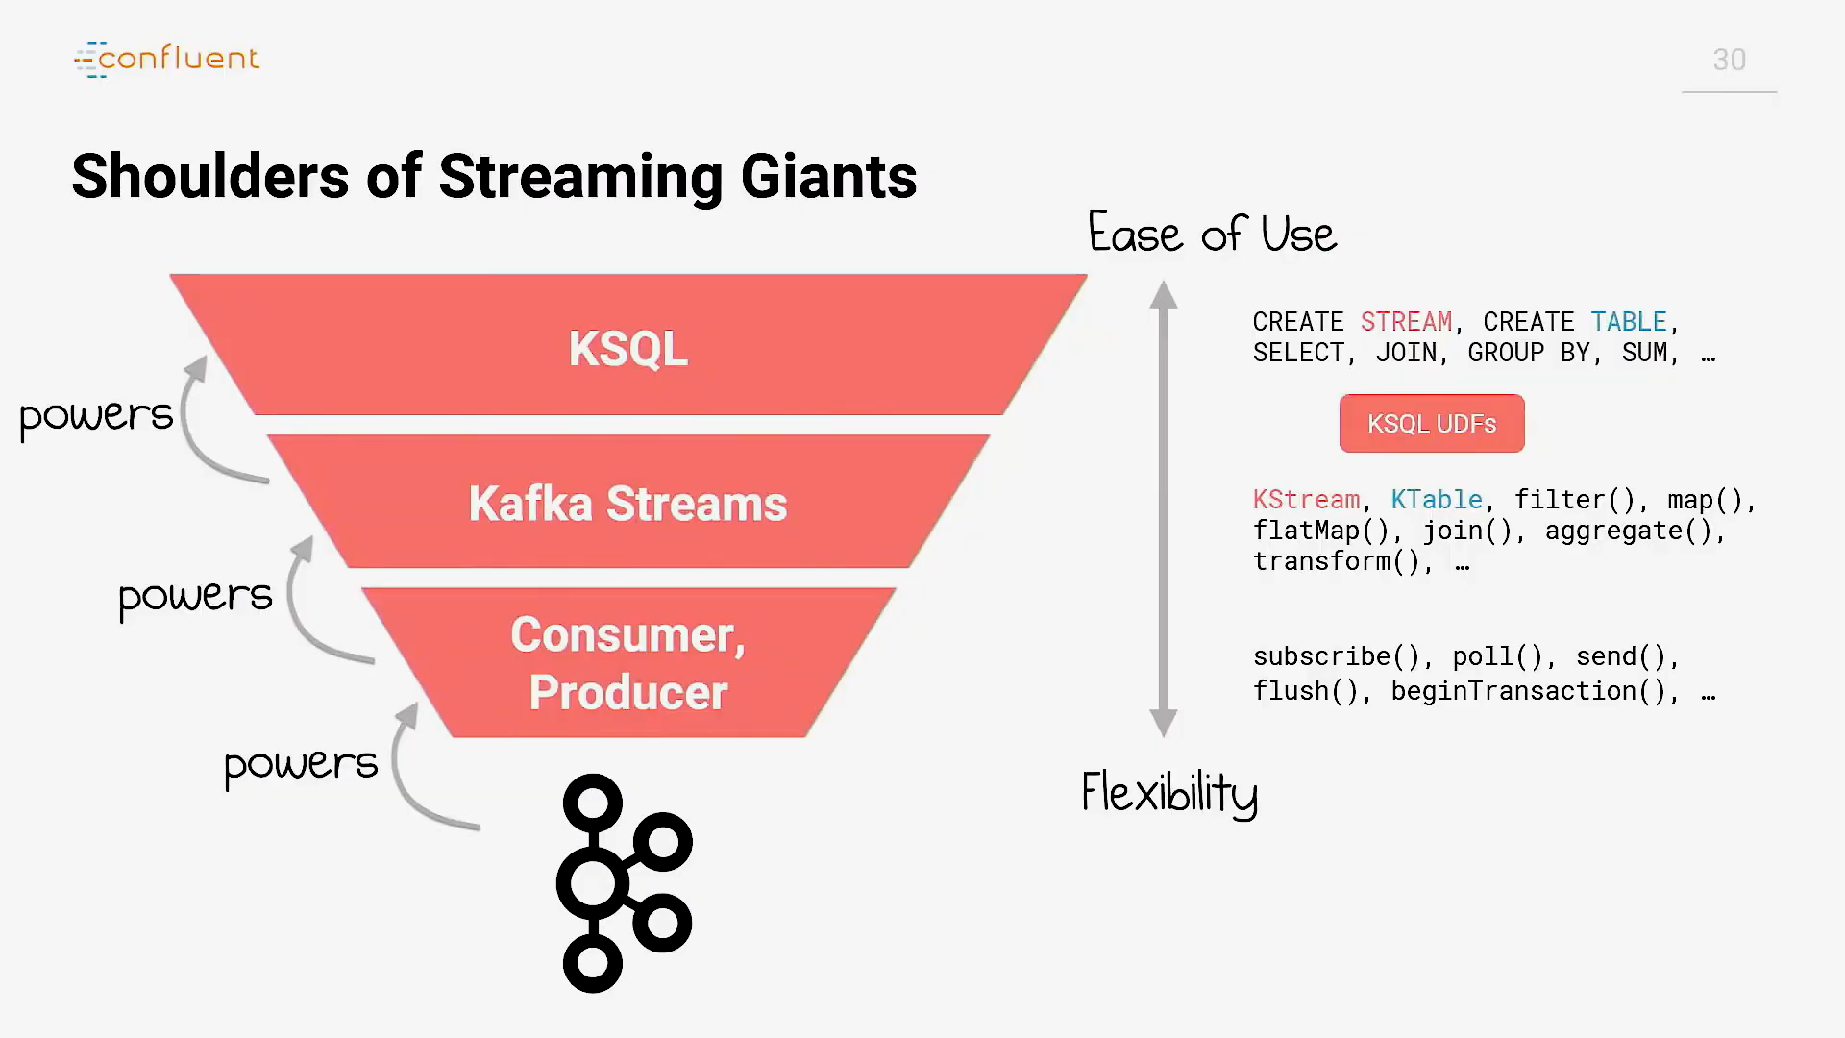

Slide 24
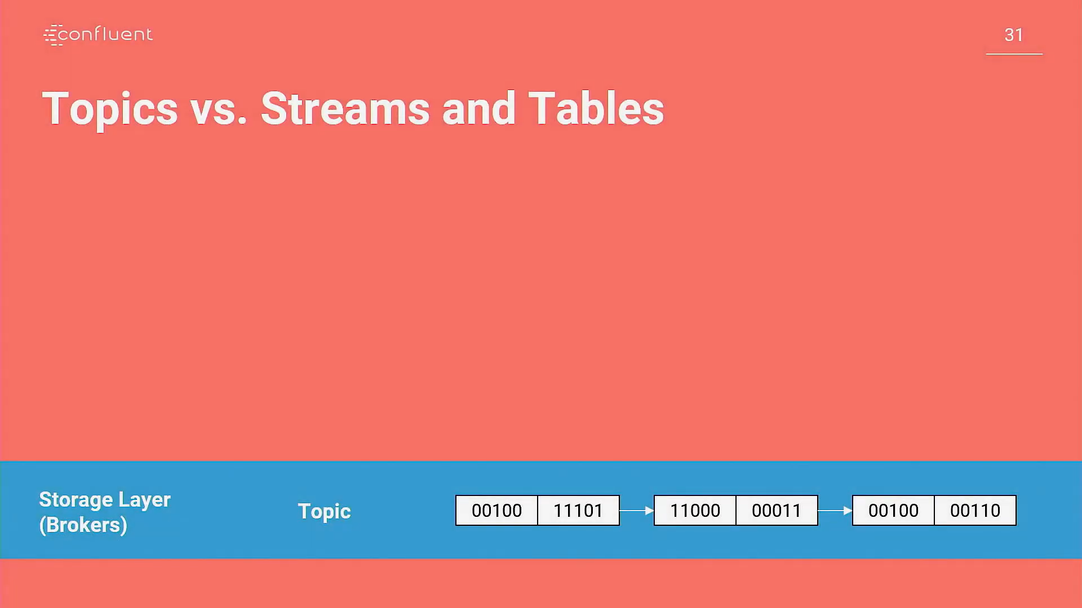

Slide 25
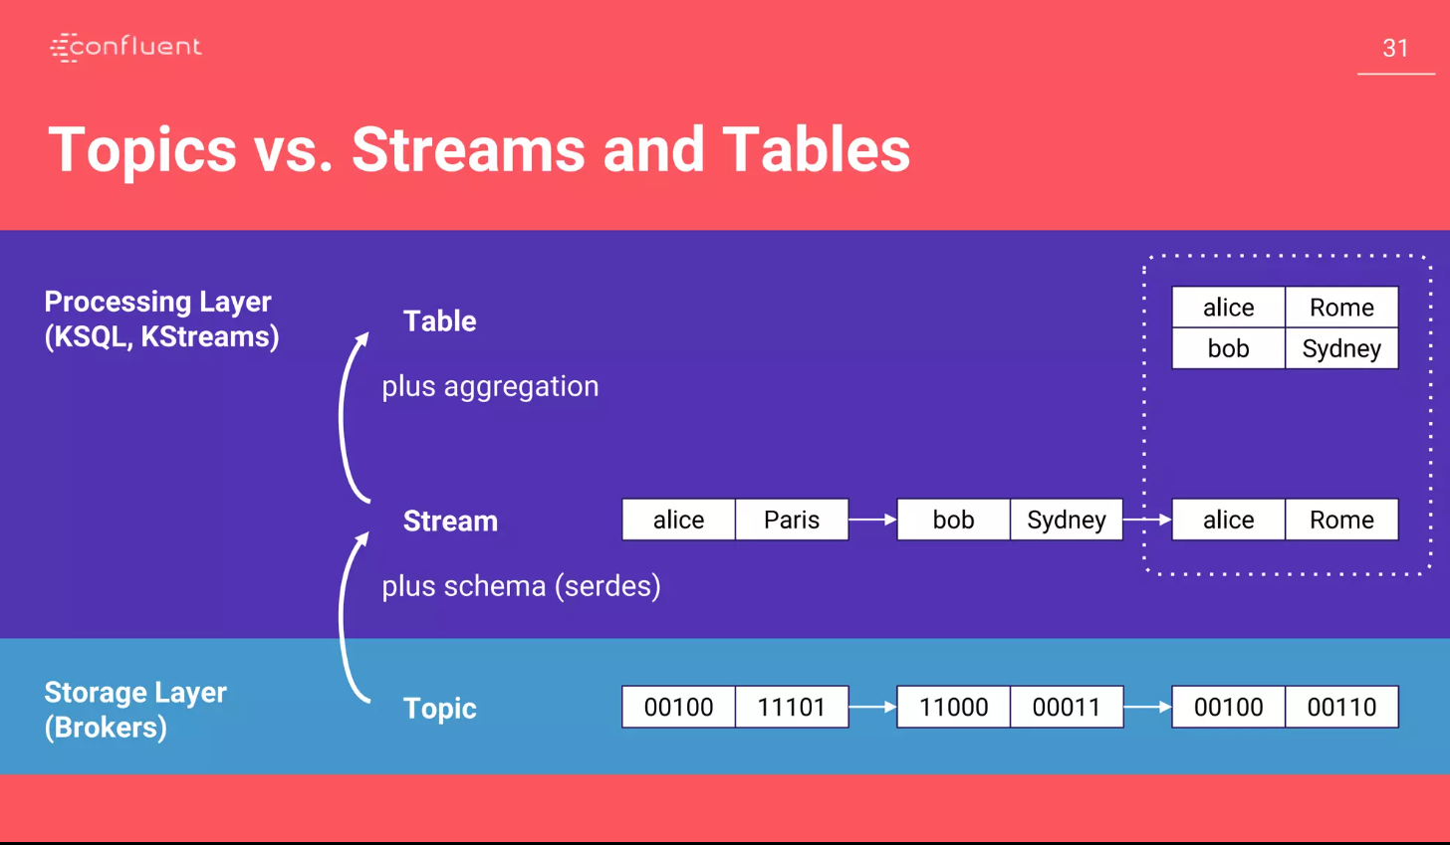

Slide 26


Slide 27
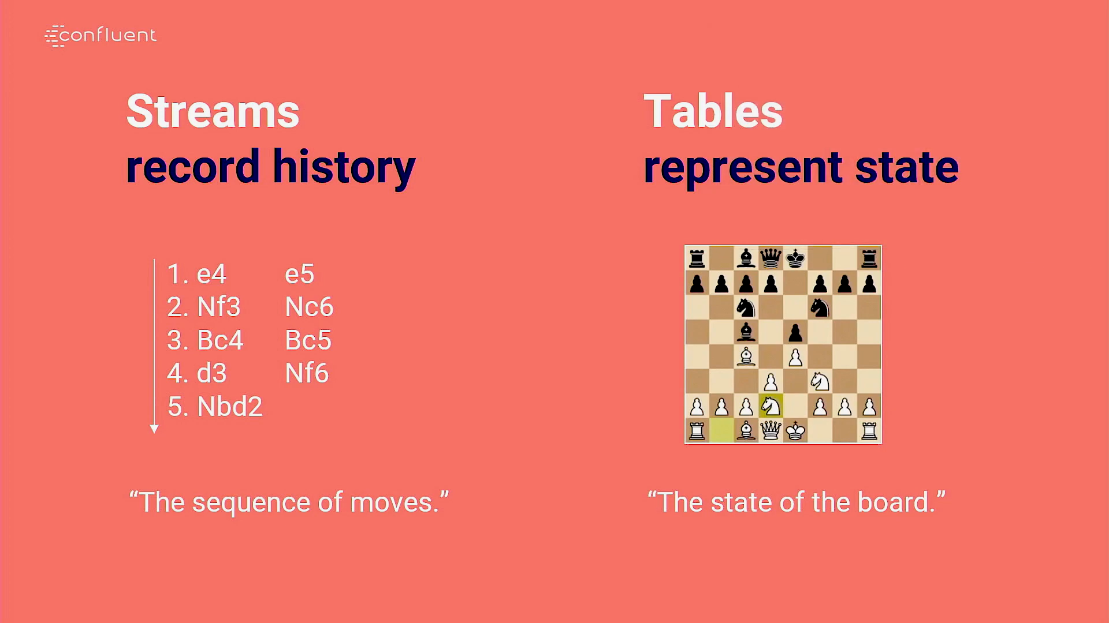

Slide 28
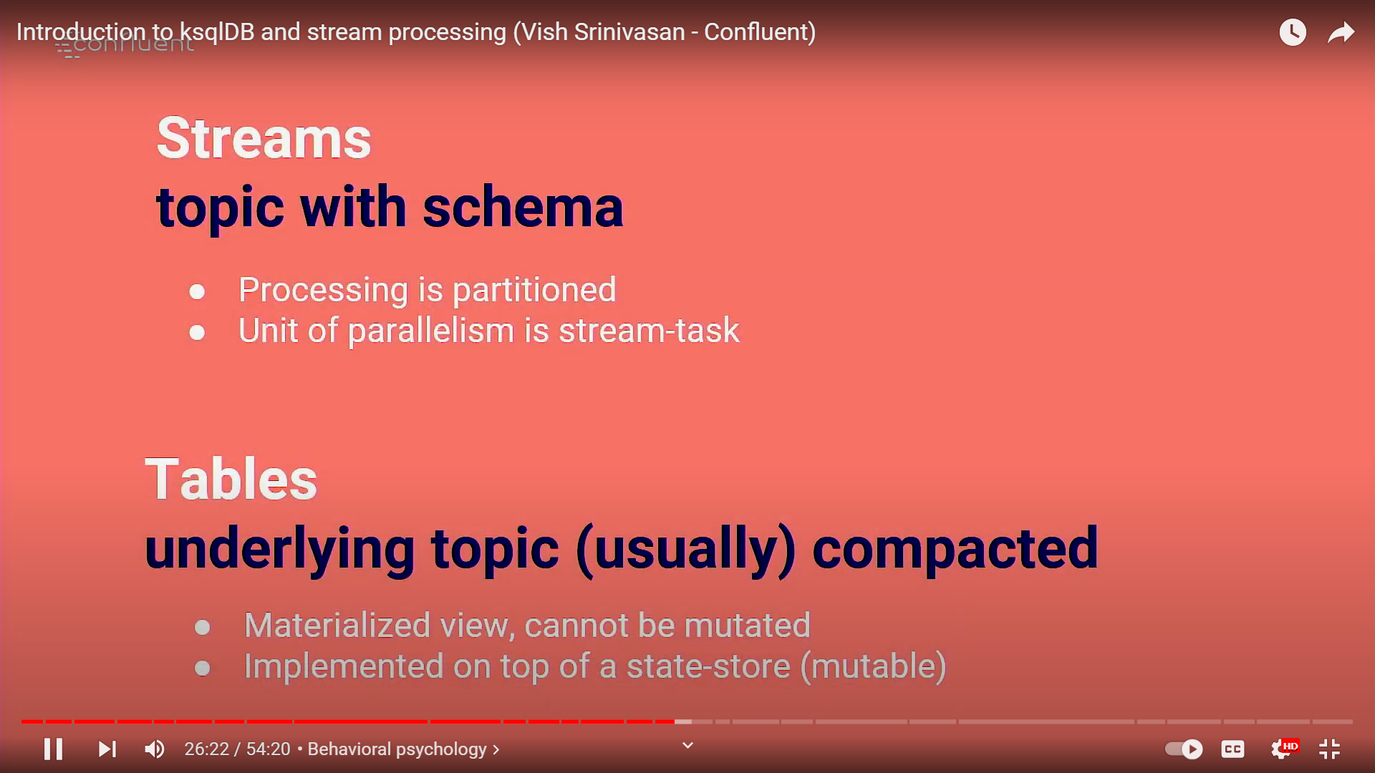

Slide 29
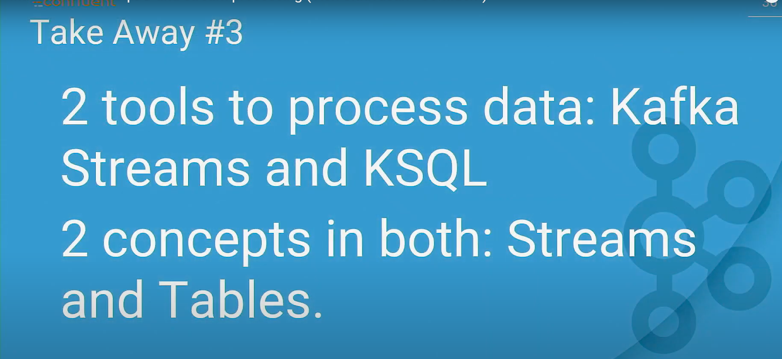

Slide 30
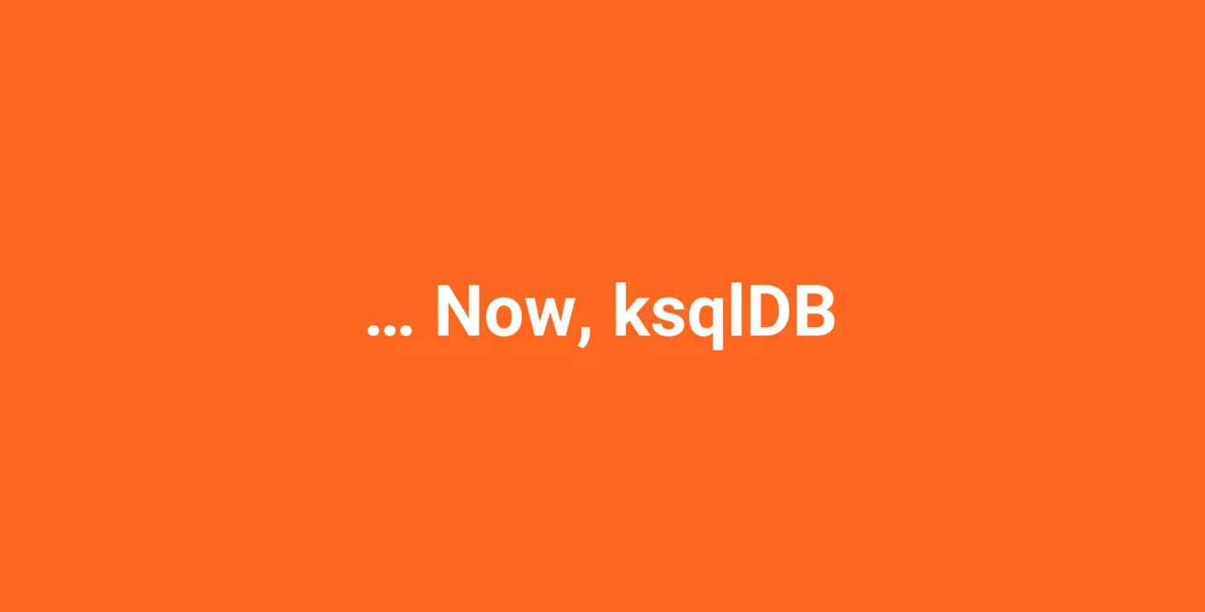

Slide 31
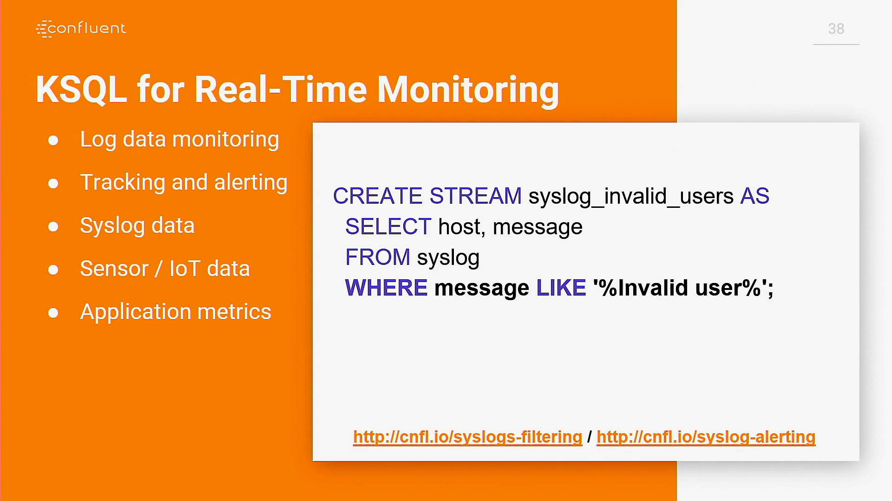

Slide 32
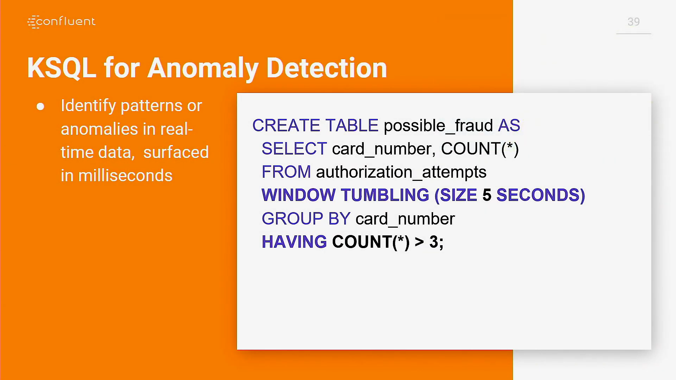

Slide 33
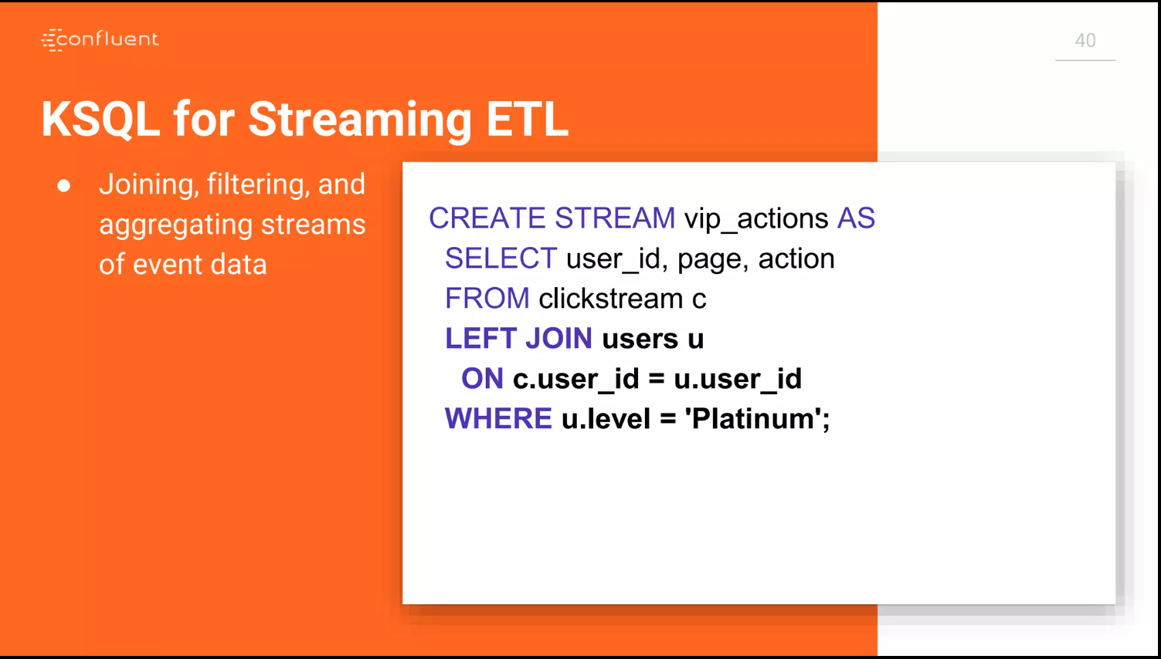

Slide 34
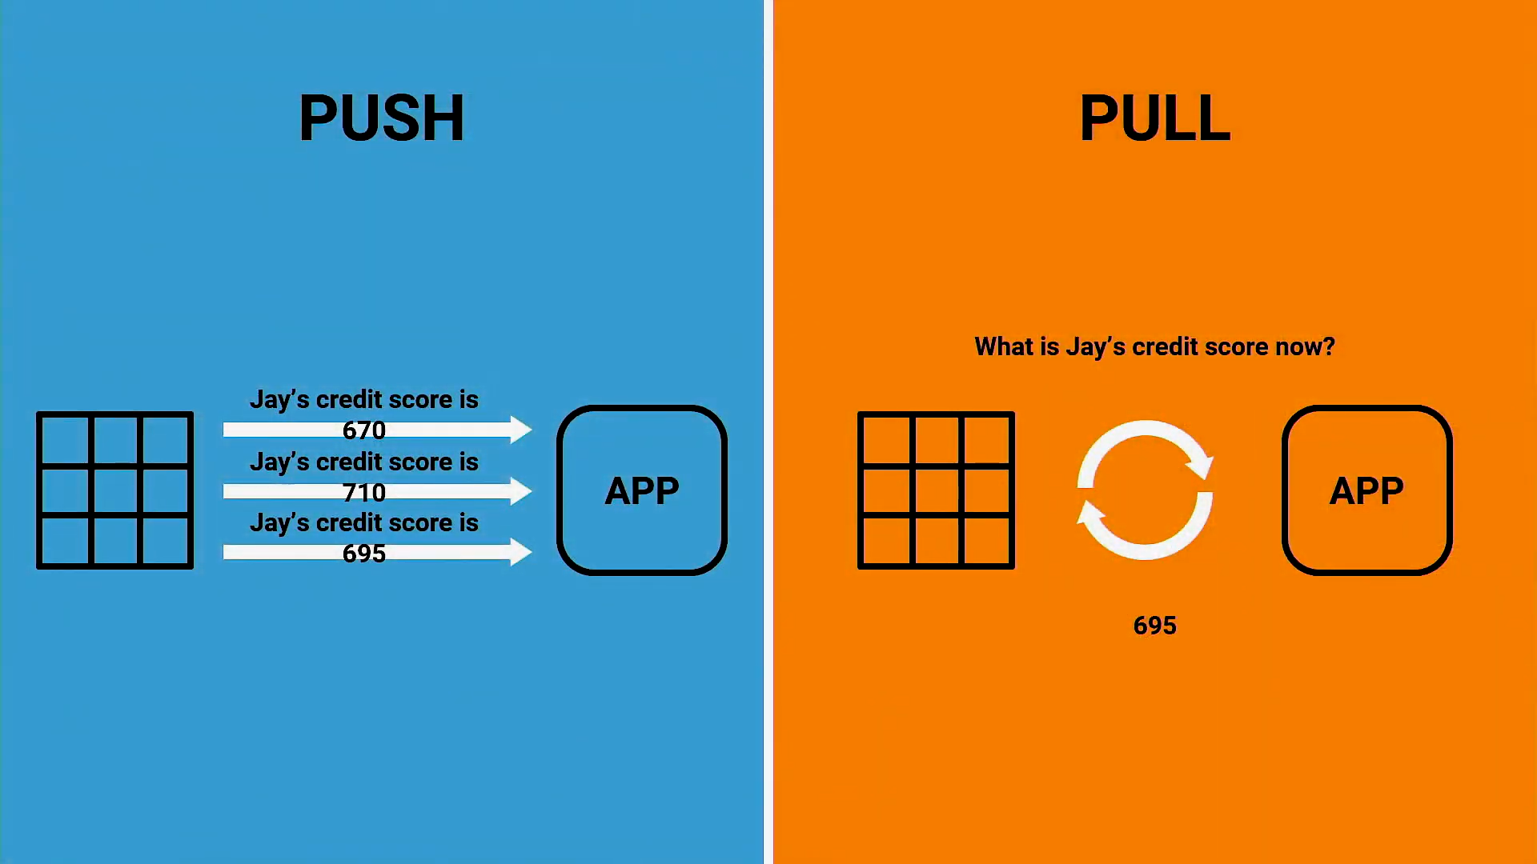

Slide 35
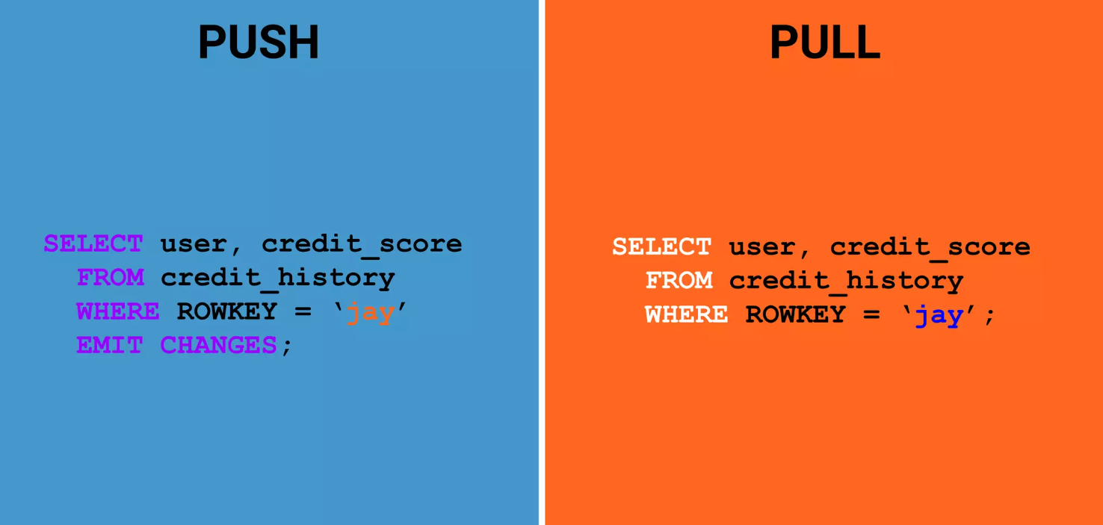

Slide 36
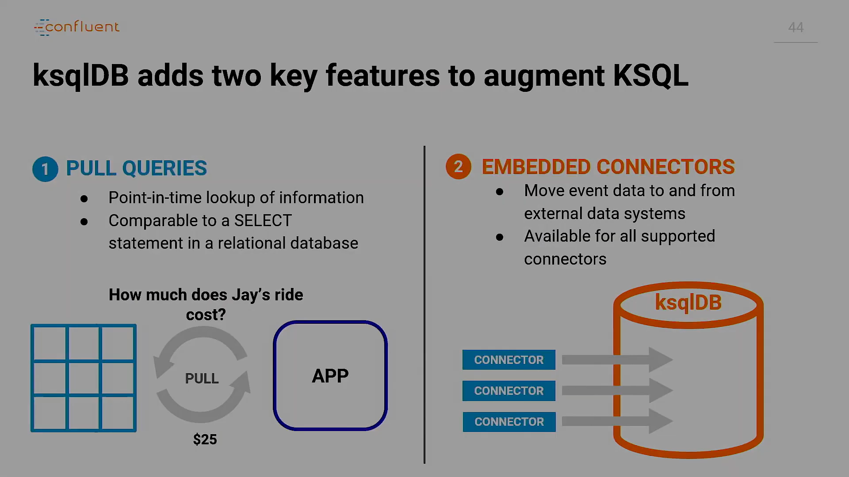

Slide 37
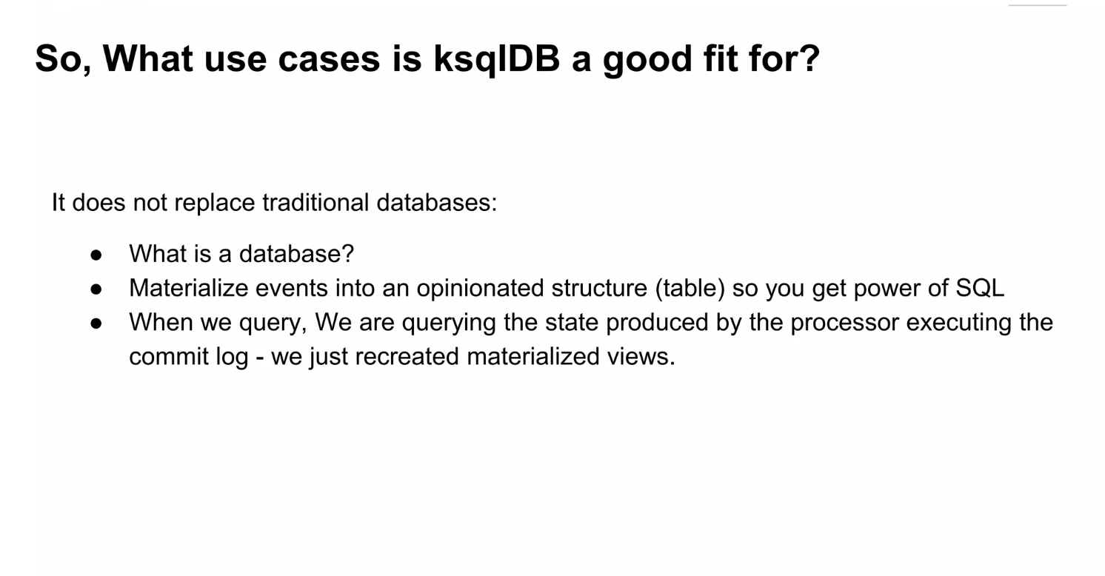

Slide 38
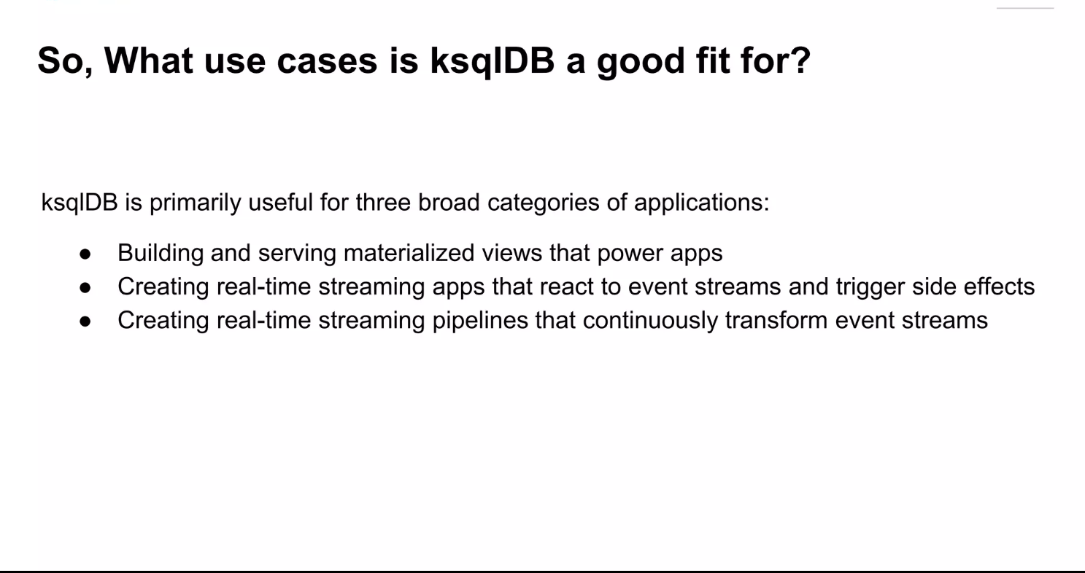

Slide 39
KSQL DB Architecture

Slide 40
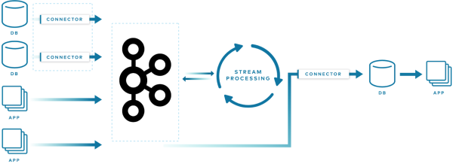

Slide 41
An architecture with ksqlDB is much simpler, as many of those external parts have been consolidated into the tool itself: ksqlDB has primitives for connectors, and it performs stream processing. It also features materialized views, so that your data can be queried just like a database table directly in ksqlDB, without needing to be sent to an external source:

Slide 42
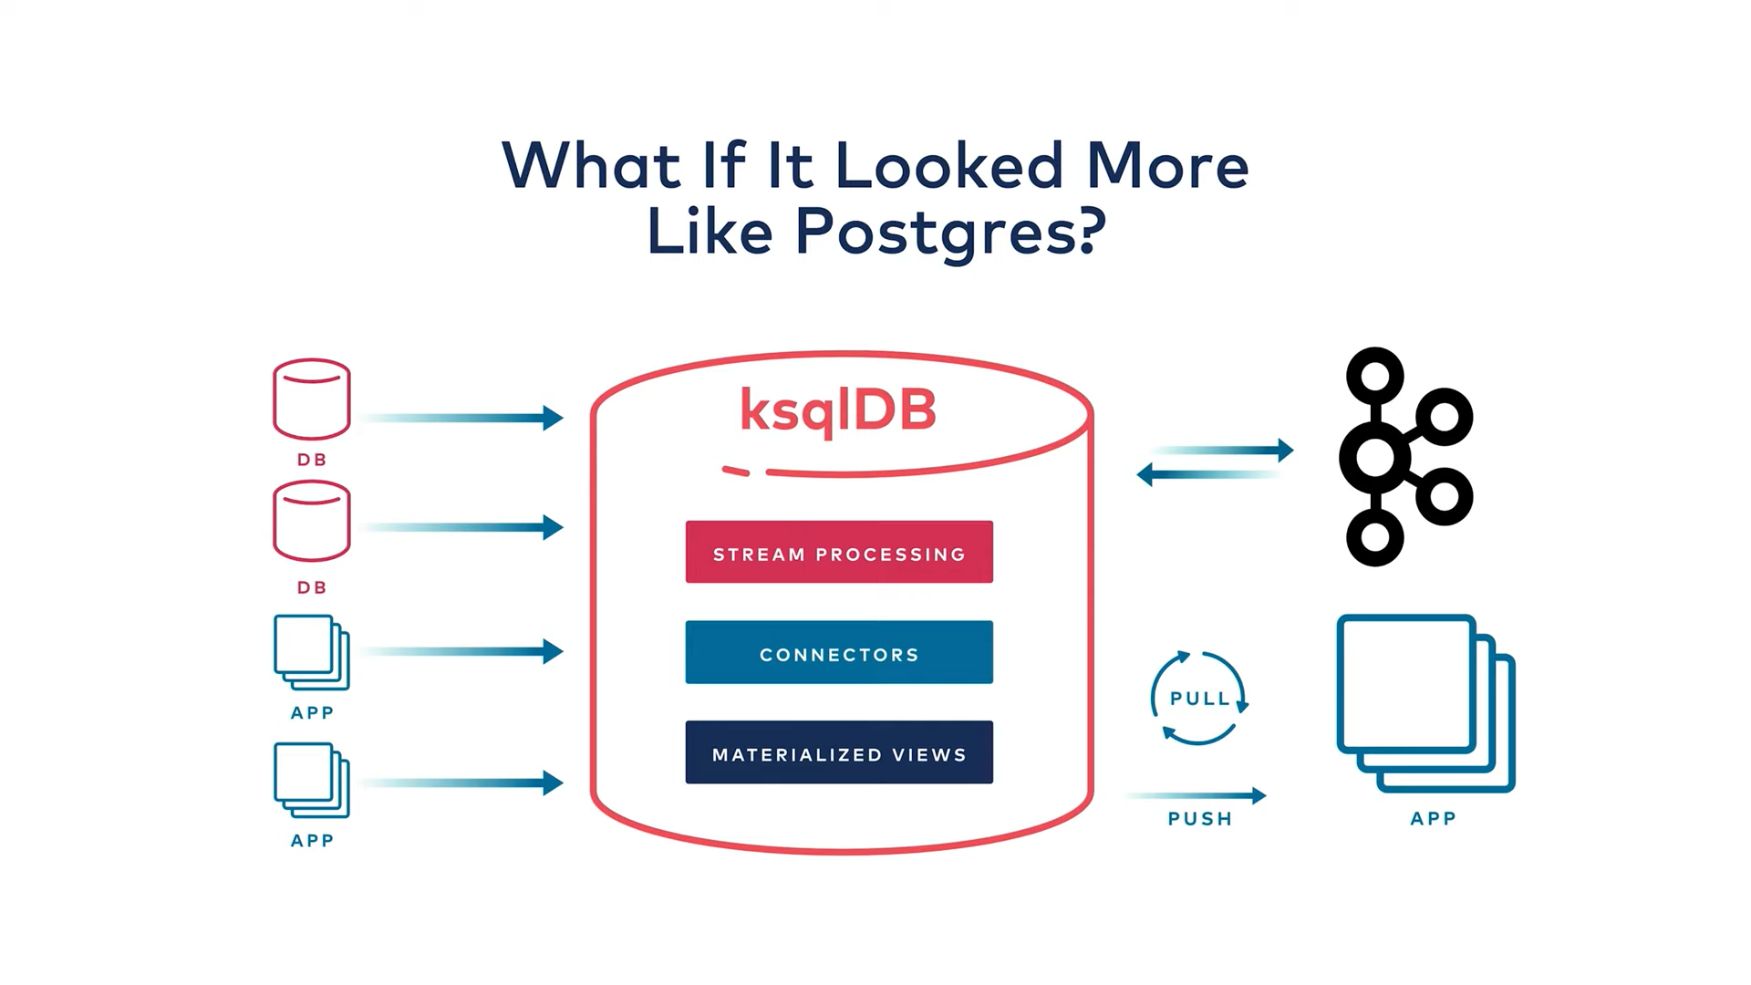

Slide 43
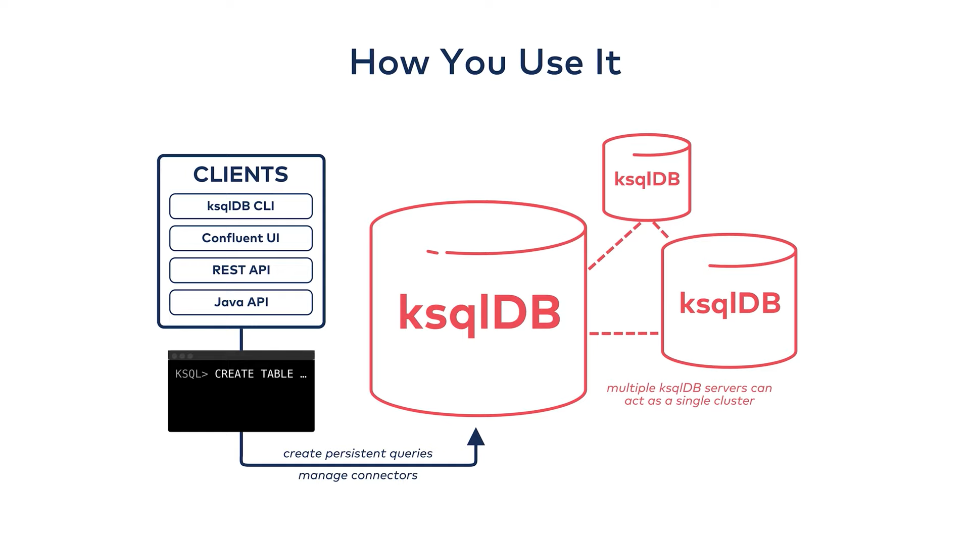

Slide 44
How Stateless Operations Work

Slide 45
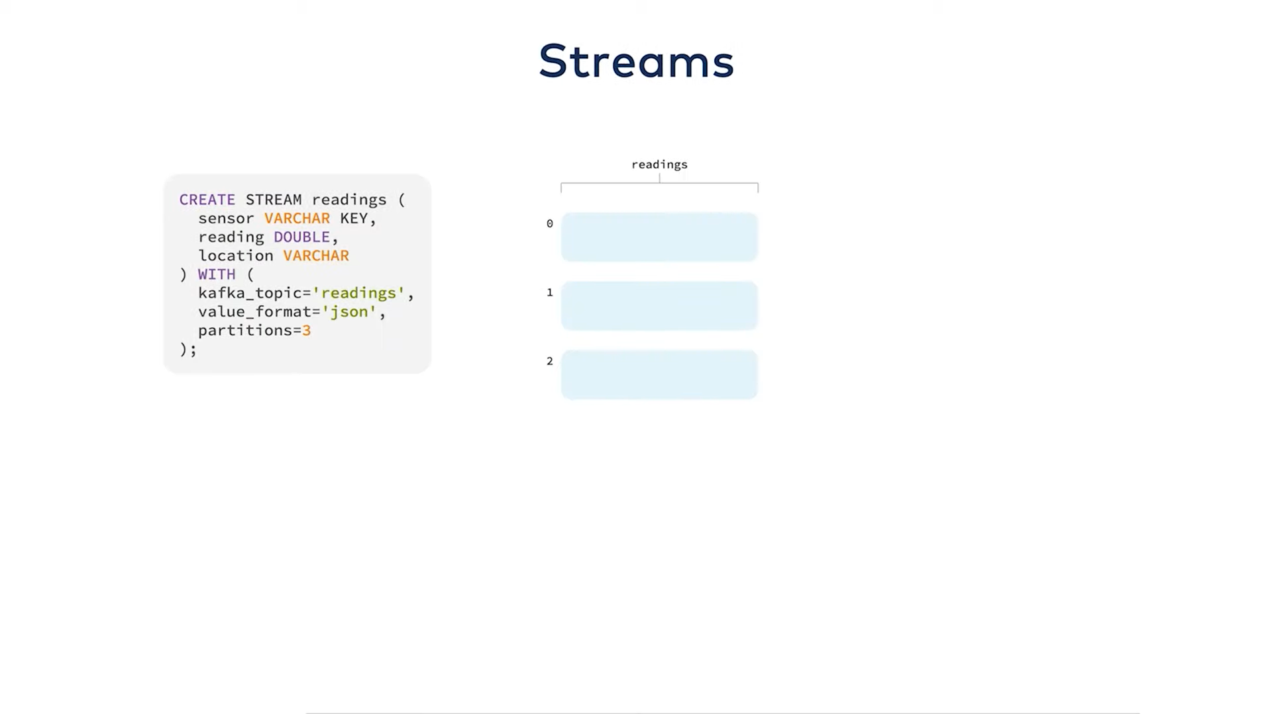

Slide 46
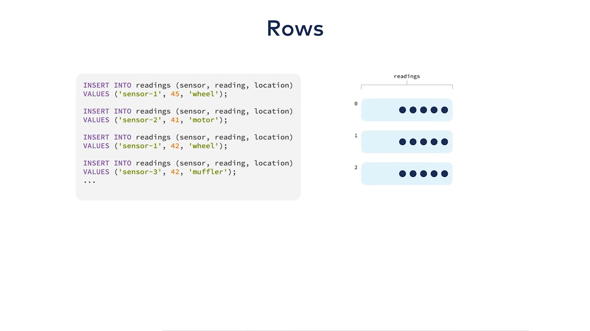

Slide 47
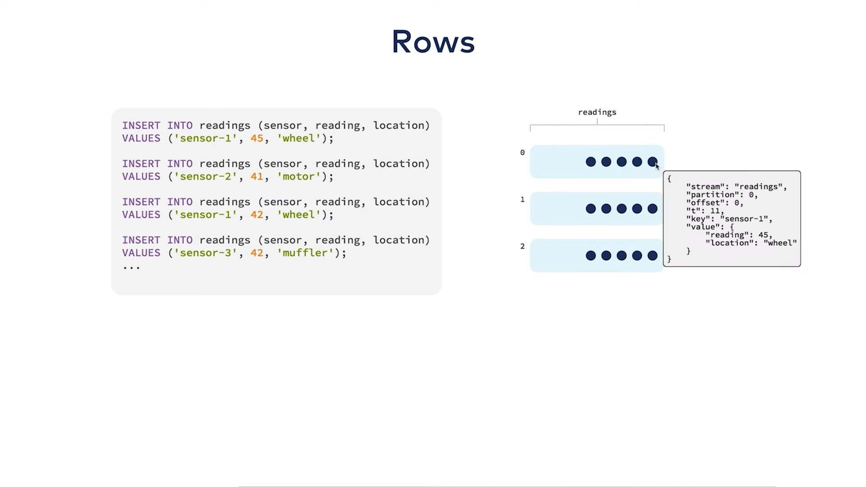

Slide 48
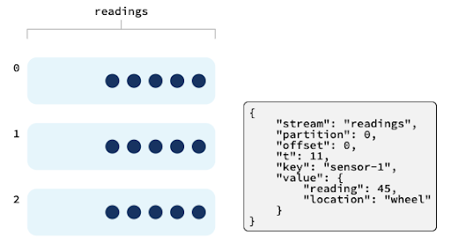

Slide 49
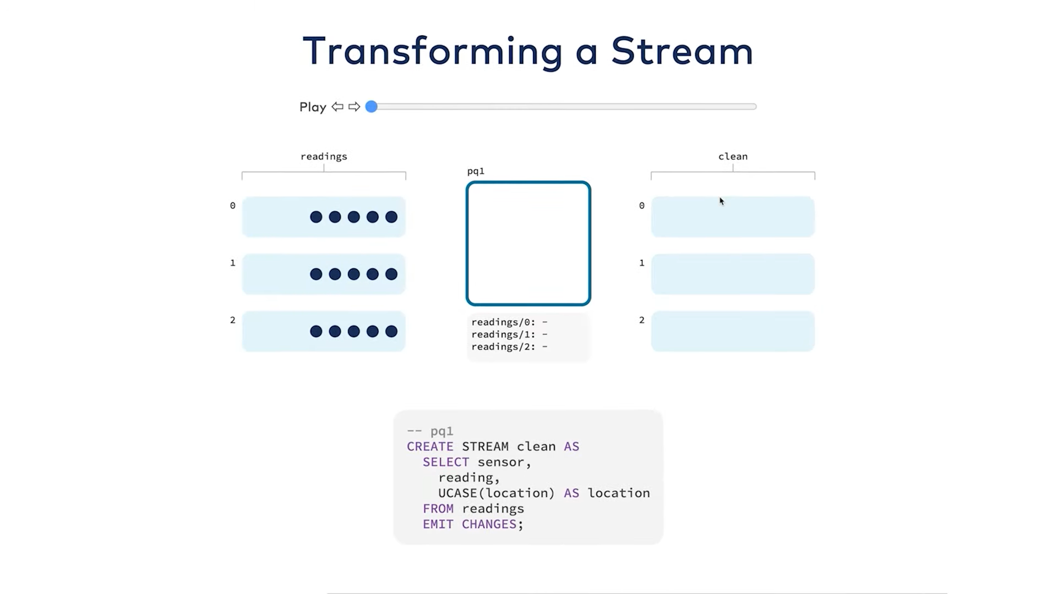

Slide 50
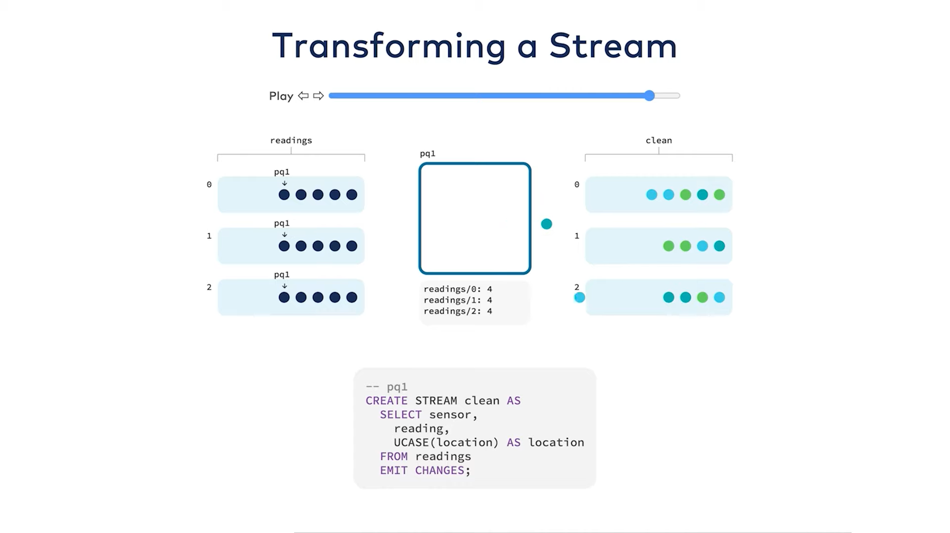

Slide 51
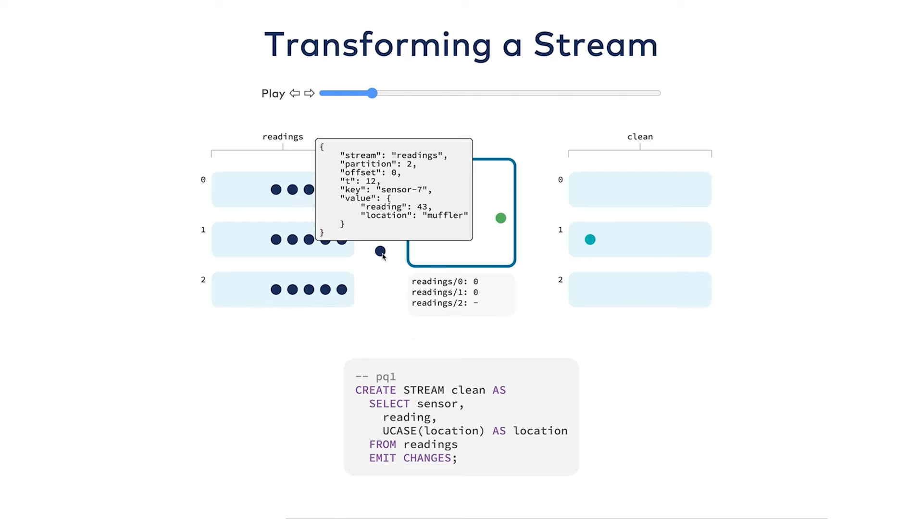

Slide 52
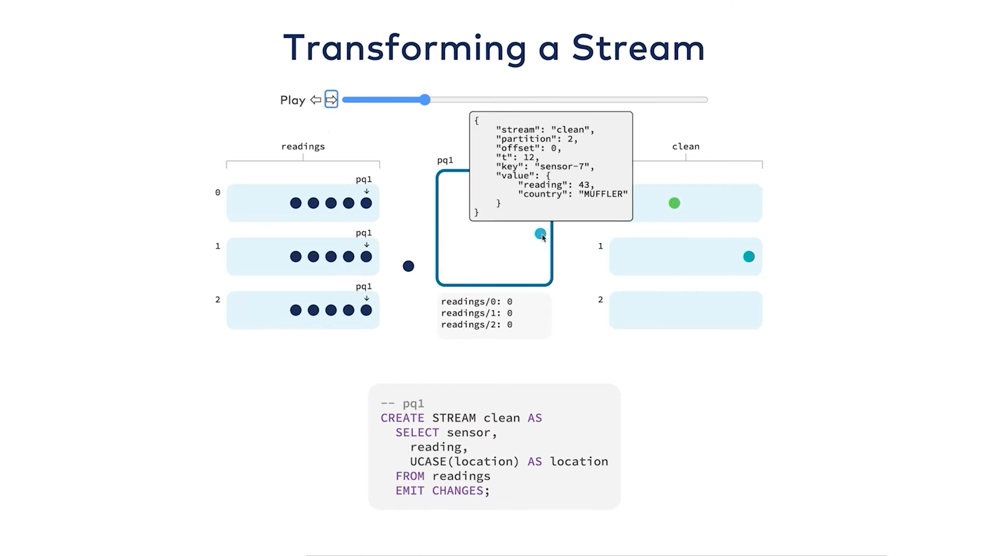

Slide 53
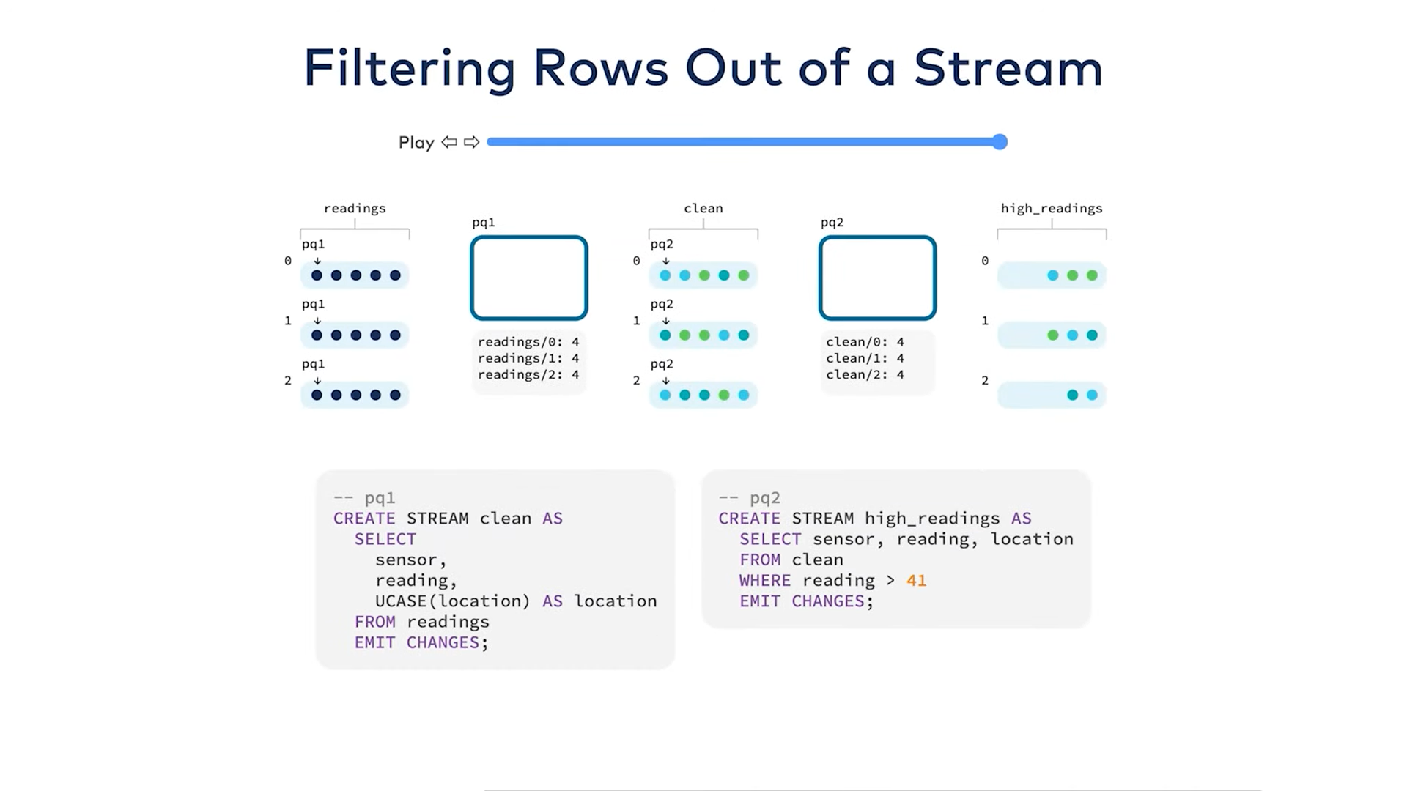

Slide 54
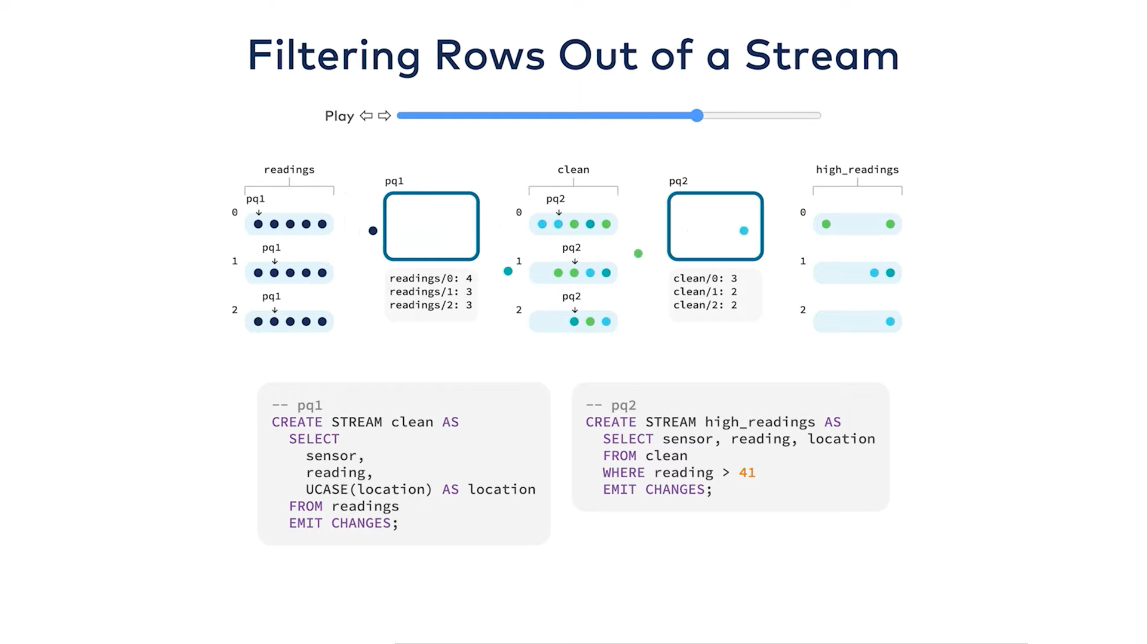

Slide 55
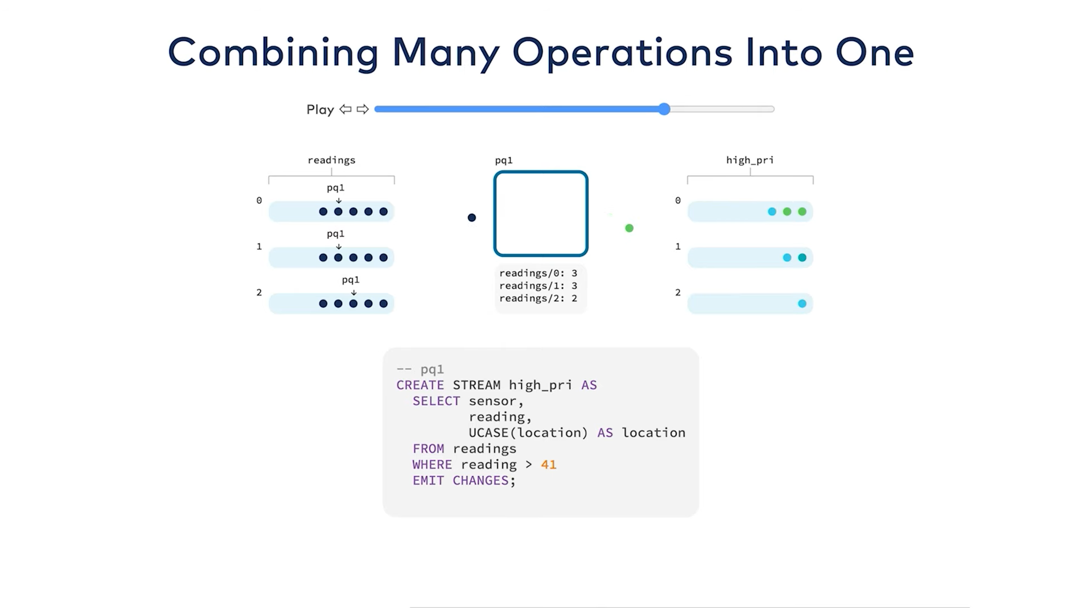

Slide 56
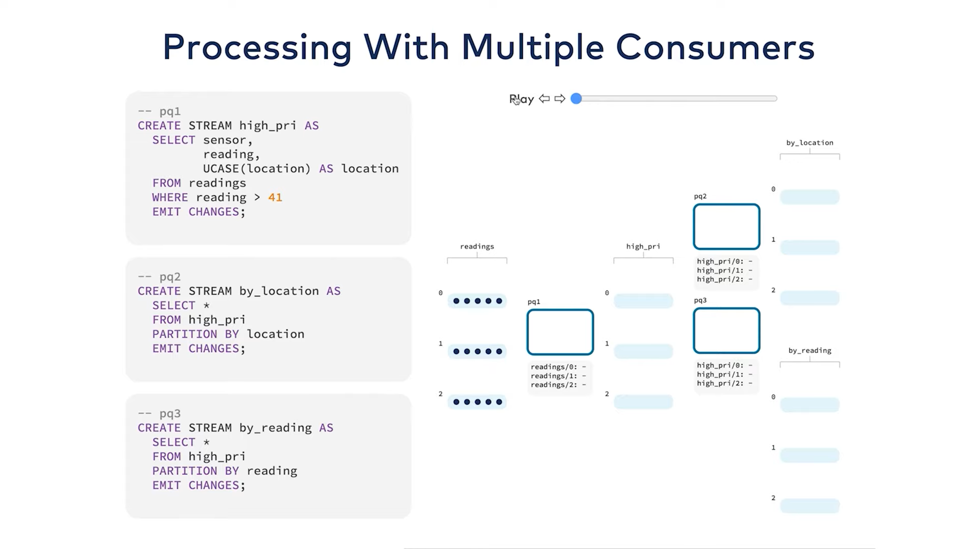

Slide 57


Slide 58
How Stateful Operations Work

Slide 59


Slide 60


Slide 61


Slide 62


Slide 63


Slide 64
Change log Keeps track of all changes

Slide 65


Slide 66
PUSH and PULL QUERY

Slide 67
ksqlDB has two options for querying data: pull queries and push queries.
Pull queries, which are run against materialized views, are similar to traditional database queries in which you query your data and then get a response. They are a process that starts, performs an operation, and then terminates. When you run a pull query at a particular moment, you get the current state of the table (the materialized view) at that specific point in time.
Push queries, on the other hand, let you subscribe to a stream of updates, and they stay alive until you stop them. So if you run a push query against a table (a materialized view), you receive an update when the state changes. In the example above, this would be every time the average reading for a sensor changes.
Pull and push queries each have distinct uses, and you pick the one to use based on your application’s requirements.

Slide 68


Slide 69


Slide 70


Slide 71


Slide 72


Slide 73


Slide 74


Slide 75


Slide 76


Slide 77


Slide 78
Add a Slide Title - 4

